Slide 1
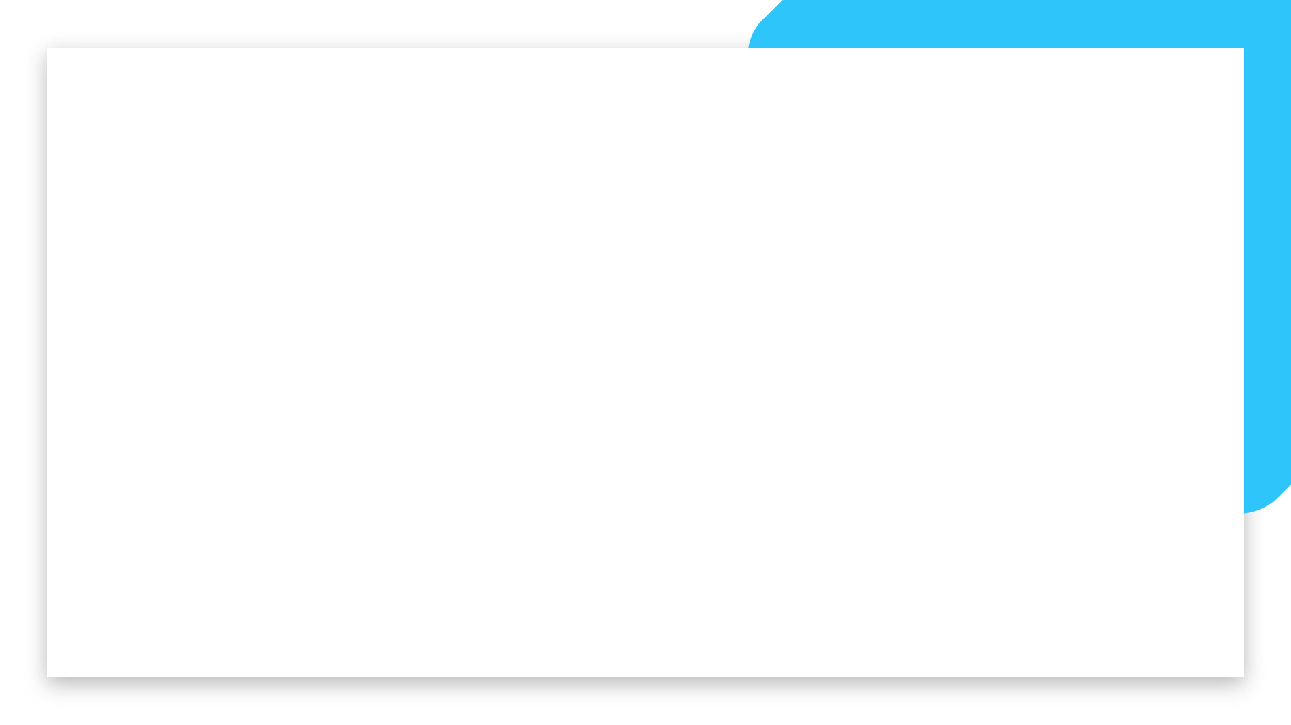


Data Science and Machine Learning
Bootcamp
IRON KAGGLE

Slide 2
Iron Kaggle
LETS COMPETE! Before you jump further, we want you to have an end-to-end experience of solving a Machine Learning problem.
So let’s try and predict the sales of shops, shall we?
You have a dataset containing information on shops’ sales per day (and several characteristics of them) - your goal is to predict the sales!
Welcome

Slide 3
Iron Kaggle
Training data (640841 entries): we will share with you a training set of store sales per day, with bits of information of what happened in that day in that store.
Real-Life Data (+70k entries): we will also share with you entries without the sales. This will be used (on the teachers side) to verify how good your model really is!
Welcome

Slide 4
Iron Kaggle
Expected Deliver:
“Real-life data set” with an extra column called “sales”, with your predictions (in .csv)
An expected value of R2 of performance of your model
A 5’ presentation on the choices you did and the road you took
Welcome

Slide 5
Iron Kaggle
Groups (similar to the room):
G1 – Edward + Gerardo
G2 – Jose + Cindy + Joshua
G3 – Jaime + Latif + Juan
G4 – Ignacio + Jesus
G5 – Alex + Larry + Victor
Welcome

Slide 6
Iron Kaggle
Schedule:
9am: Introduction, Group organization, framing the problem
9.30am: Development time
12pm: Lunch break
1pm: You will receive the “real-life” data
1pm: Development time + presentation creation
3.30pm: Delivery of the real life data
3.30pm-4pm: Finish your presentation
4pm: presentations + winner announcement
Welcome

Slide 7
Iron Kaggle
DELIVERABLE:
A .csv file called with your groupd name (e.g, ‘G1.csv’, ‘G2.csv’)
The value of R2 you are expecting to get
Send this in a .zip file containing two elements:
the csv file
a txt file with the R2 score inside
Welcome

Slide 8
Iron Kaggle
Winners:
Winner 1 -> Group with the highest R2 score
Winner 2 -> Group with the most correct prediction of their own R2 score
BOTH CAN BE THE SAME GROUP
Welcome

Slide 9
Iron Kaggle - Results
 | Group 1: | Group 2: | Group 3: | Group 4: | Group 5:
R2 Prediction (how much your thought your model would perform) | 0.9225 | 0.9412 | 0.94987 | NA | 0.9602
R2 Score (how your model performed with real life data provided by Joao) | 0.9246 | 0.9413 | 0.94869 | NA | 0.9609
R2 Difference | 0.0021 | 0.0001 | 0.00118 | NA | 0.0007
Welcome

Slide 10
Good luck
Let’s get started!

